Slide 1
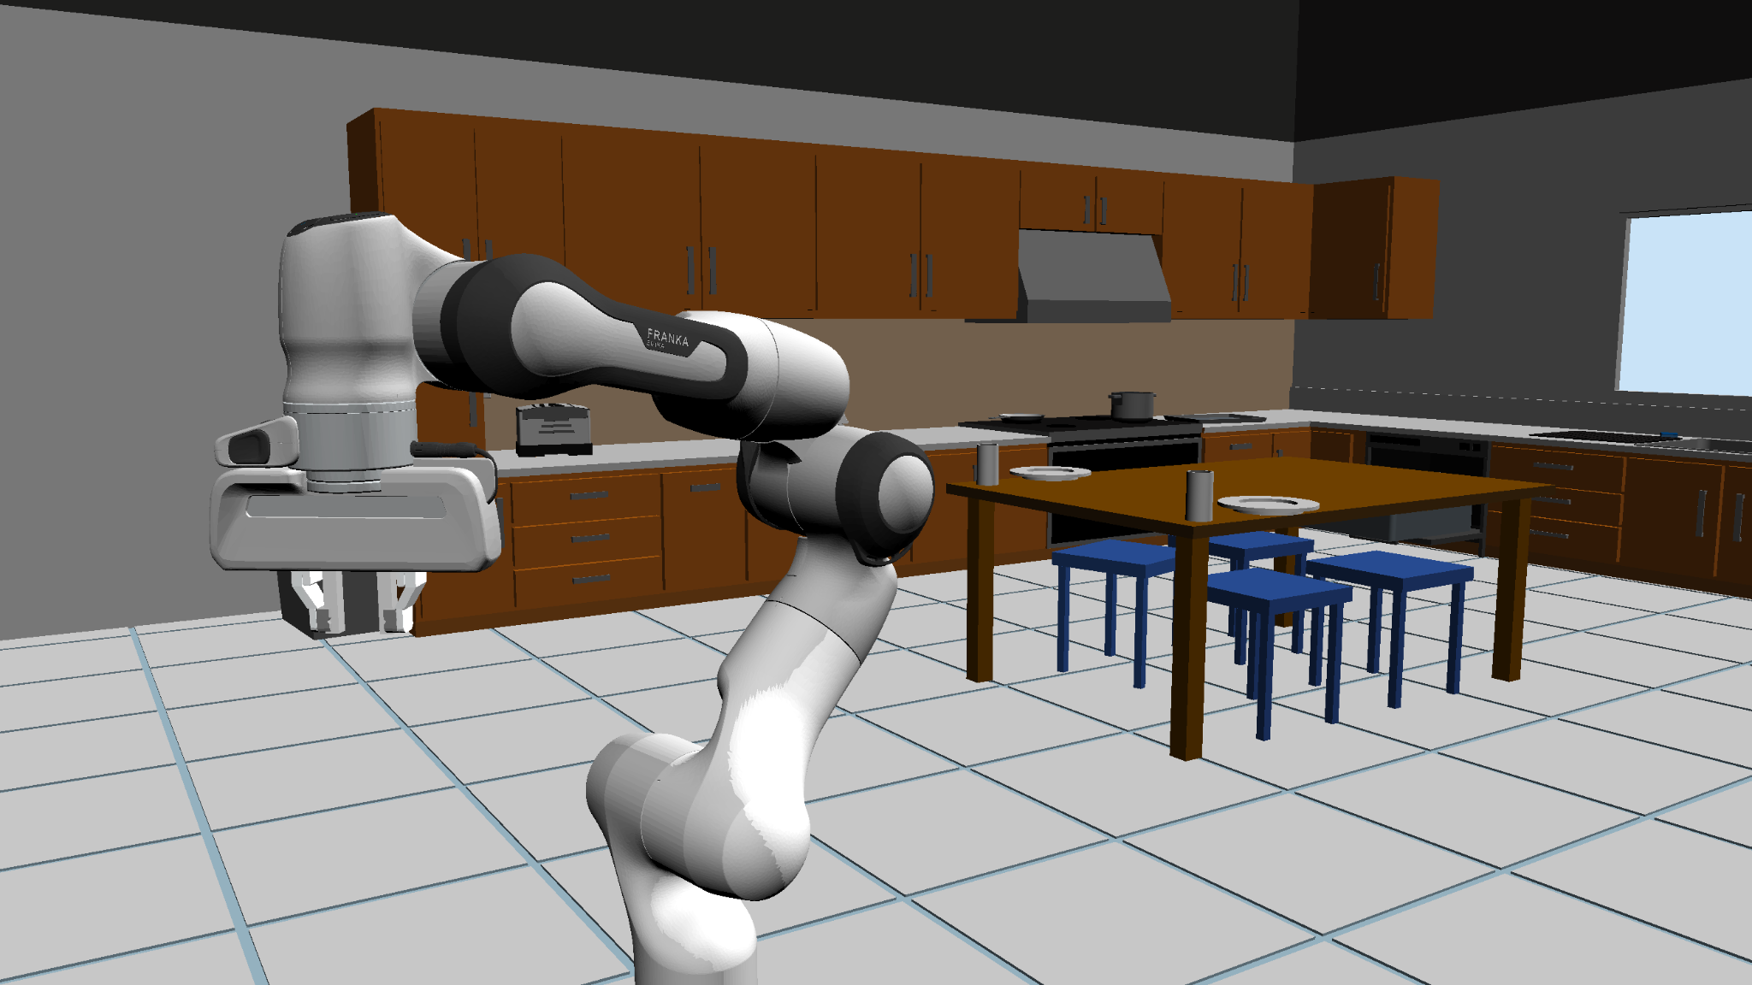
Robusser: Dish Washing Robot
CS225A Final Project Presentation
David Ihim, AJ Arnolie, Abhyudit Manhas

Slide 2
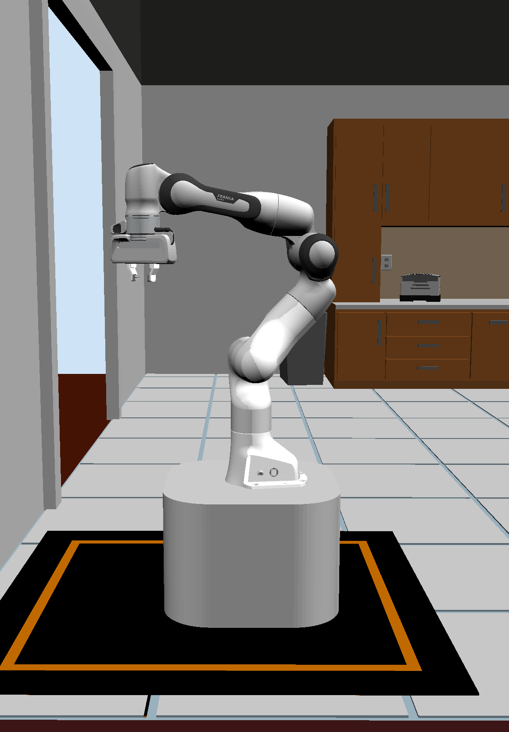
Project Description
Robot Task: Dish Washing
Motivation: Assistive Care
Given a table containing dishes in a room, the robot:
Navigate the room
Pick up the used dishes and cups
Rinse them in the sink
Then, put them in the dishwasher
Return to charging state
Robot Design:
Single moving base with one 7-DoF arm attached for picking up arbitrarily positioned objects
Arm positioned such that it can reach both the table top and dishwasher down below
Notes:
David
Motivation → Assistive Care for those who can’t do tasks like cleaning dishes on their own

Slide 3
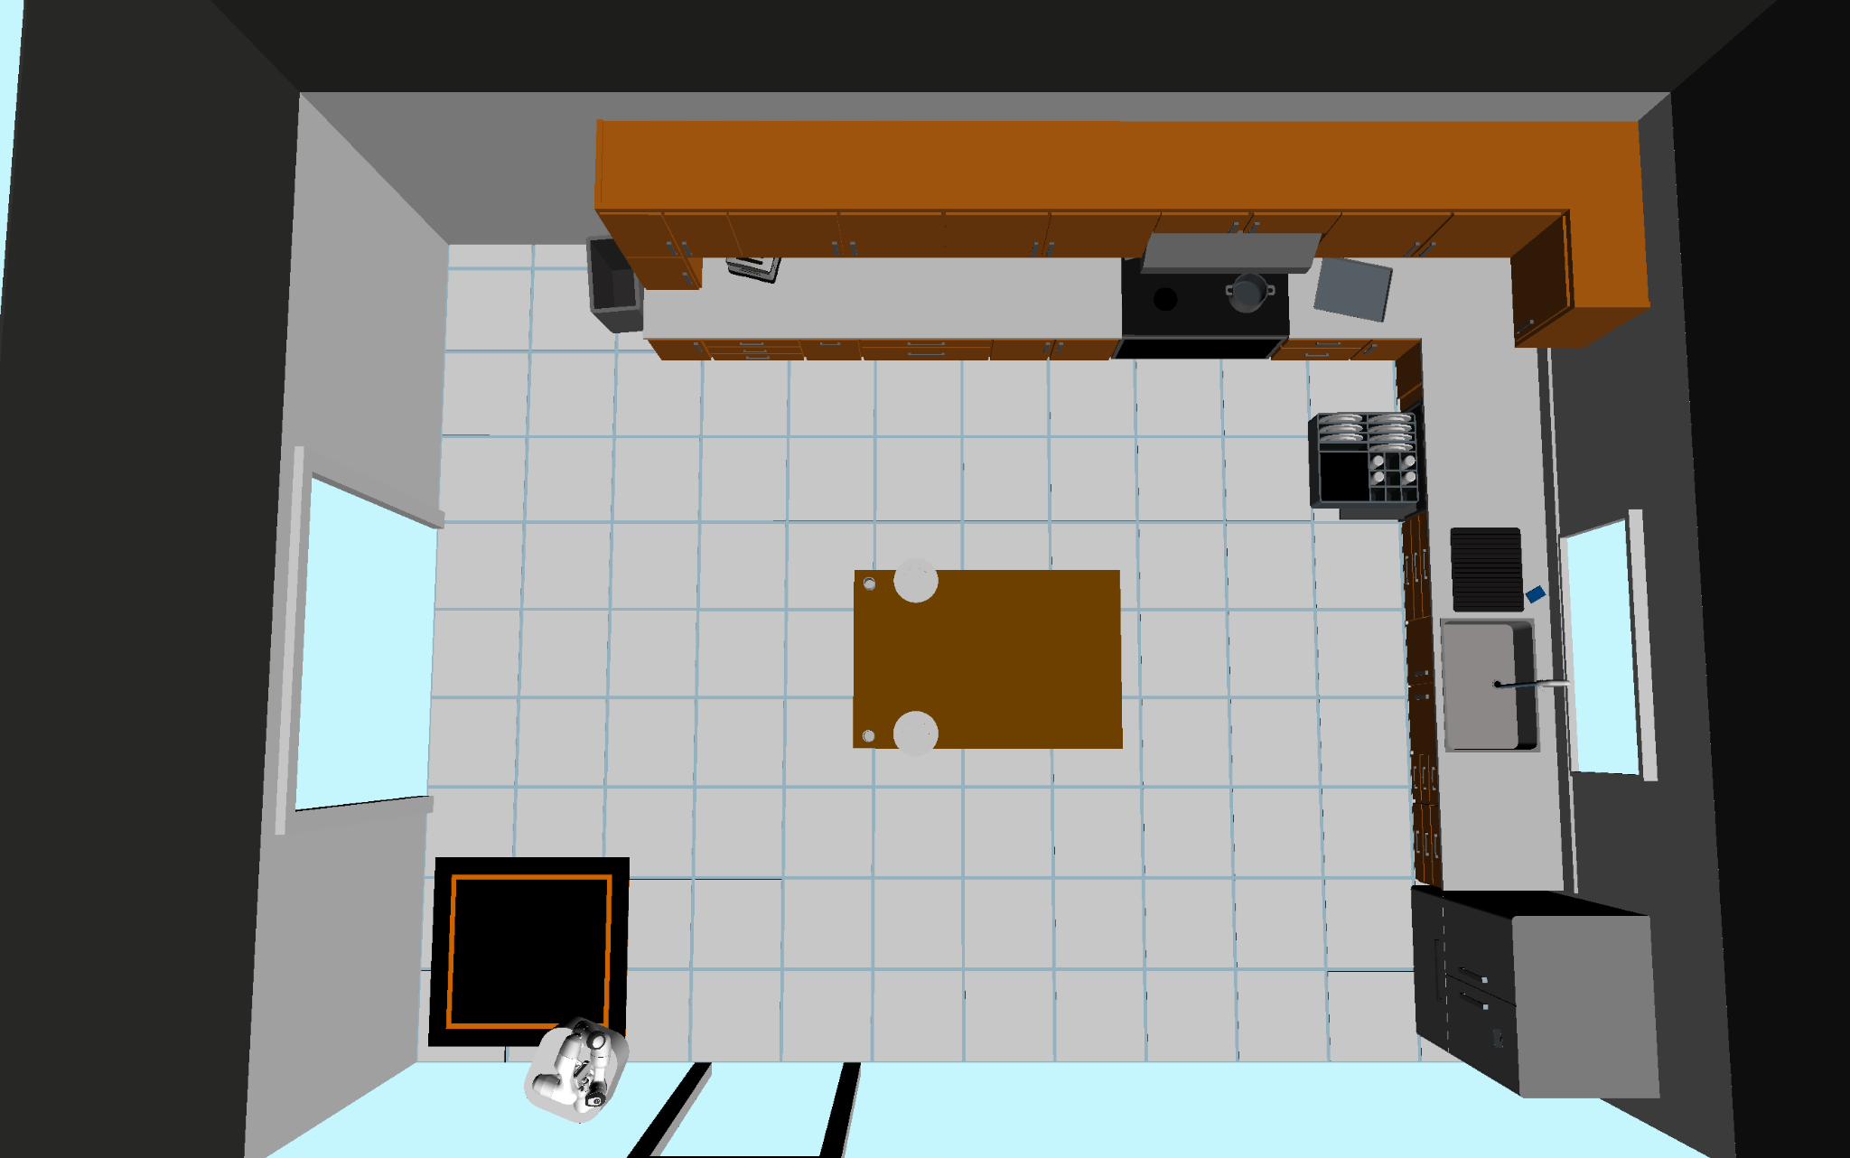
Project Environment Description
Planned Room Layout
Final Room Layout
Sink
Dishwasher
Robot
Table
Dish Washer
Plate
Plate
Plates and Cups
Table
Sink
Plate
Plate
Charging Area
Robot
Charging
Area

Slide 4
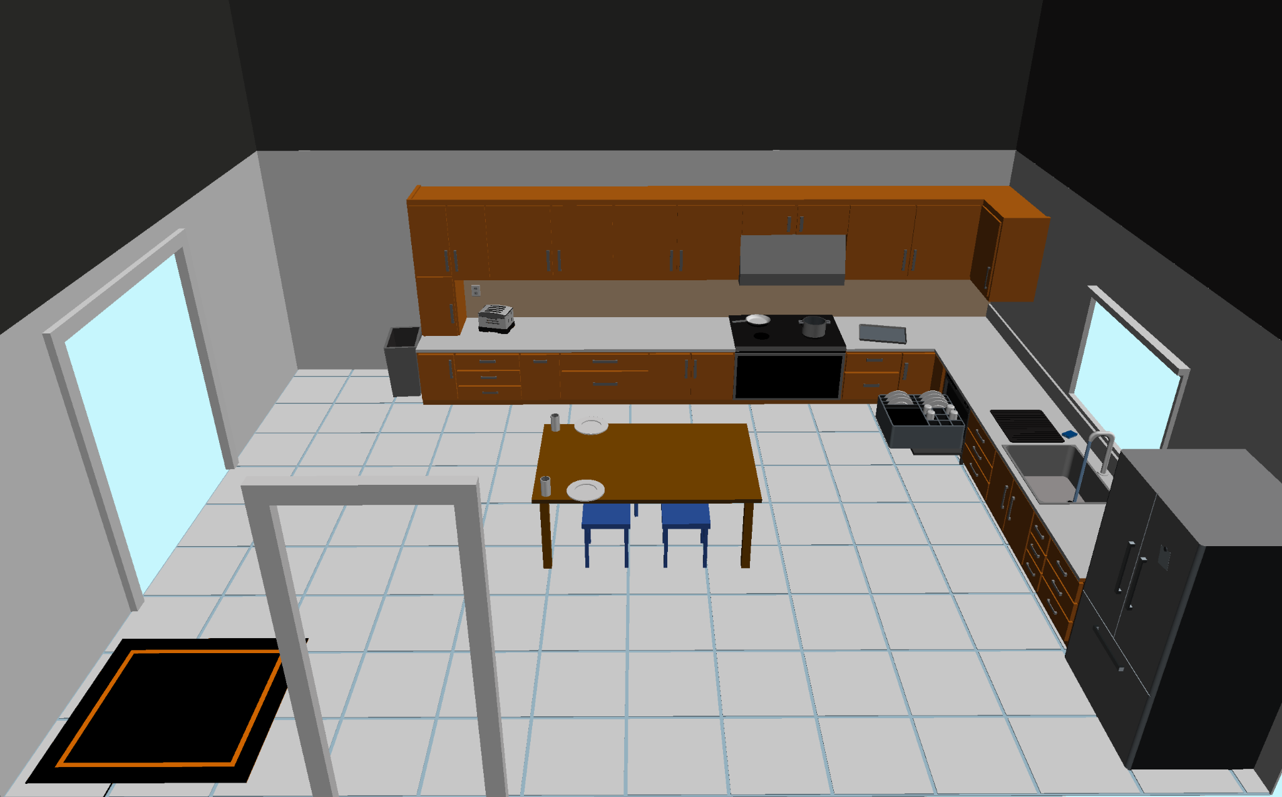
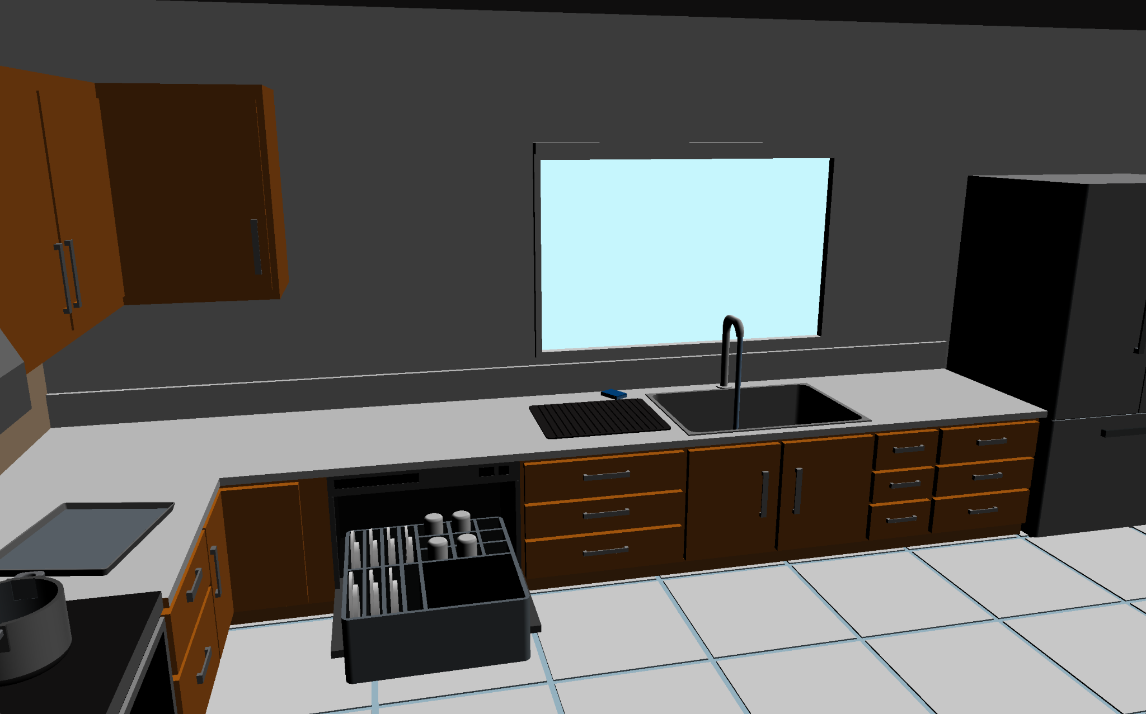
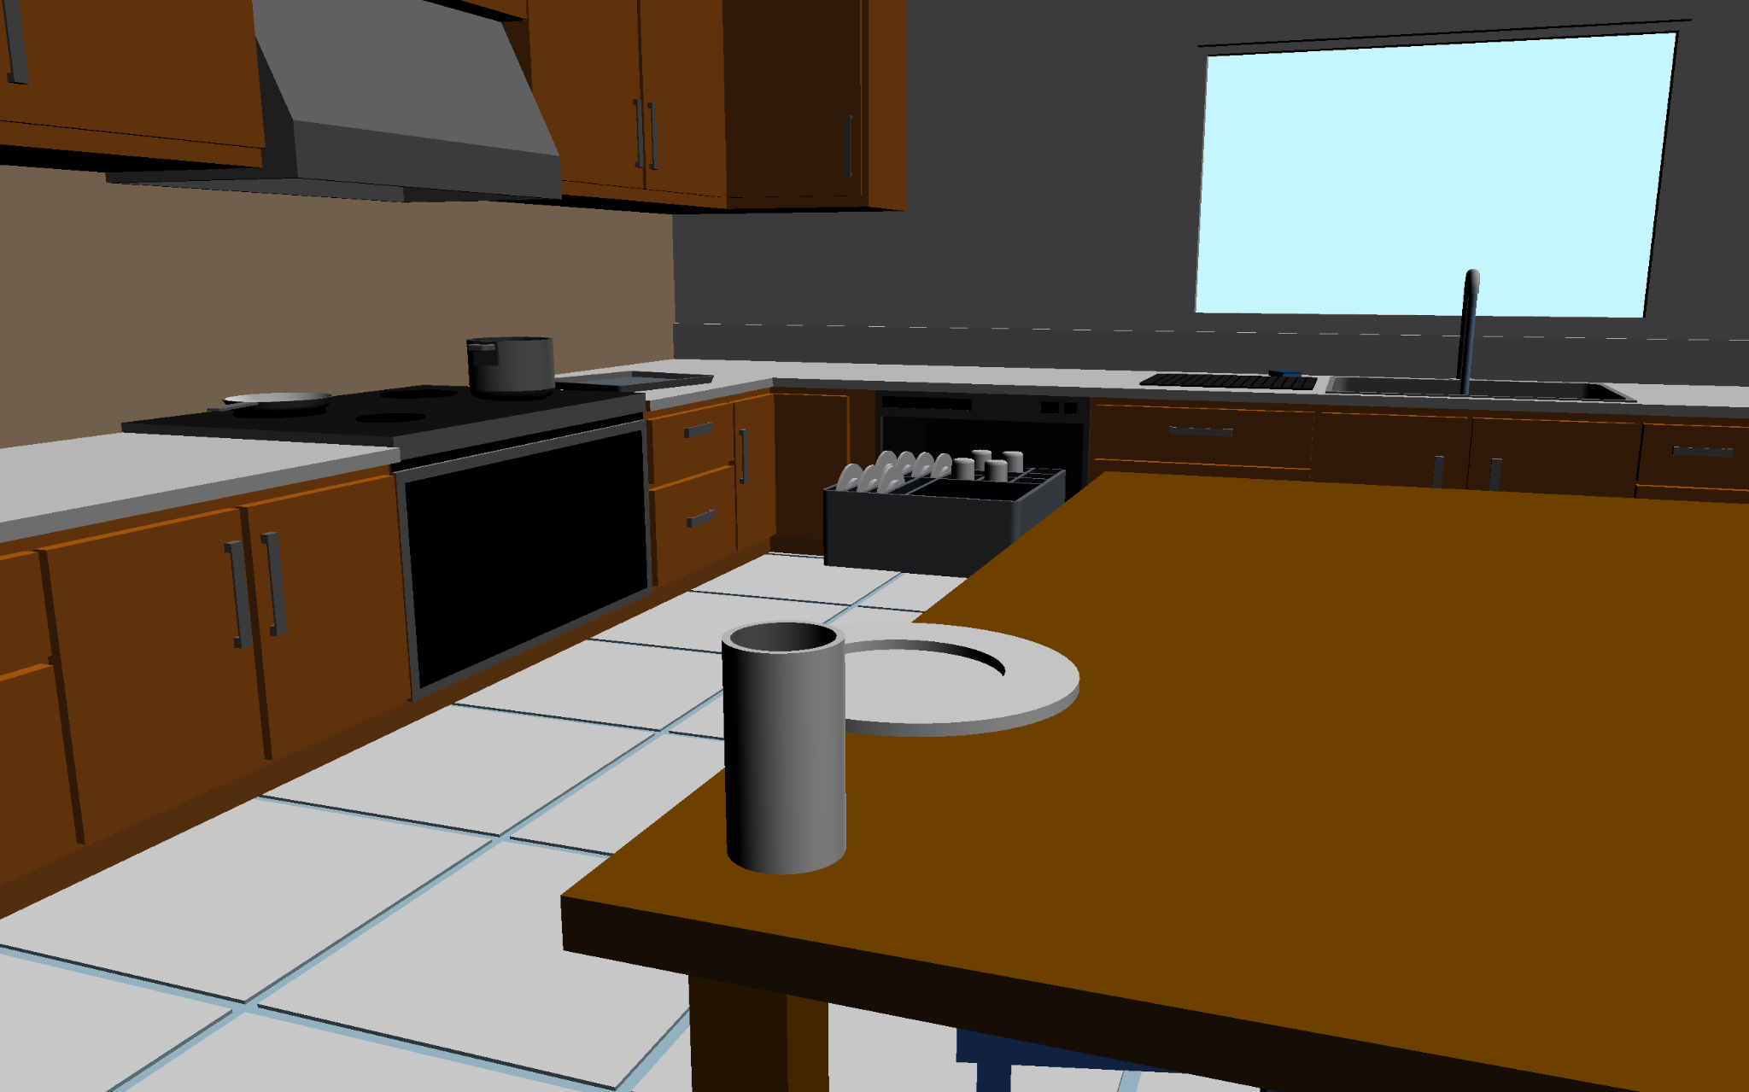
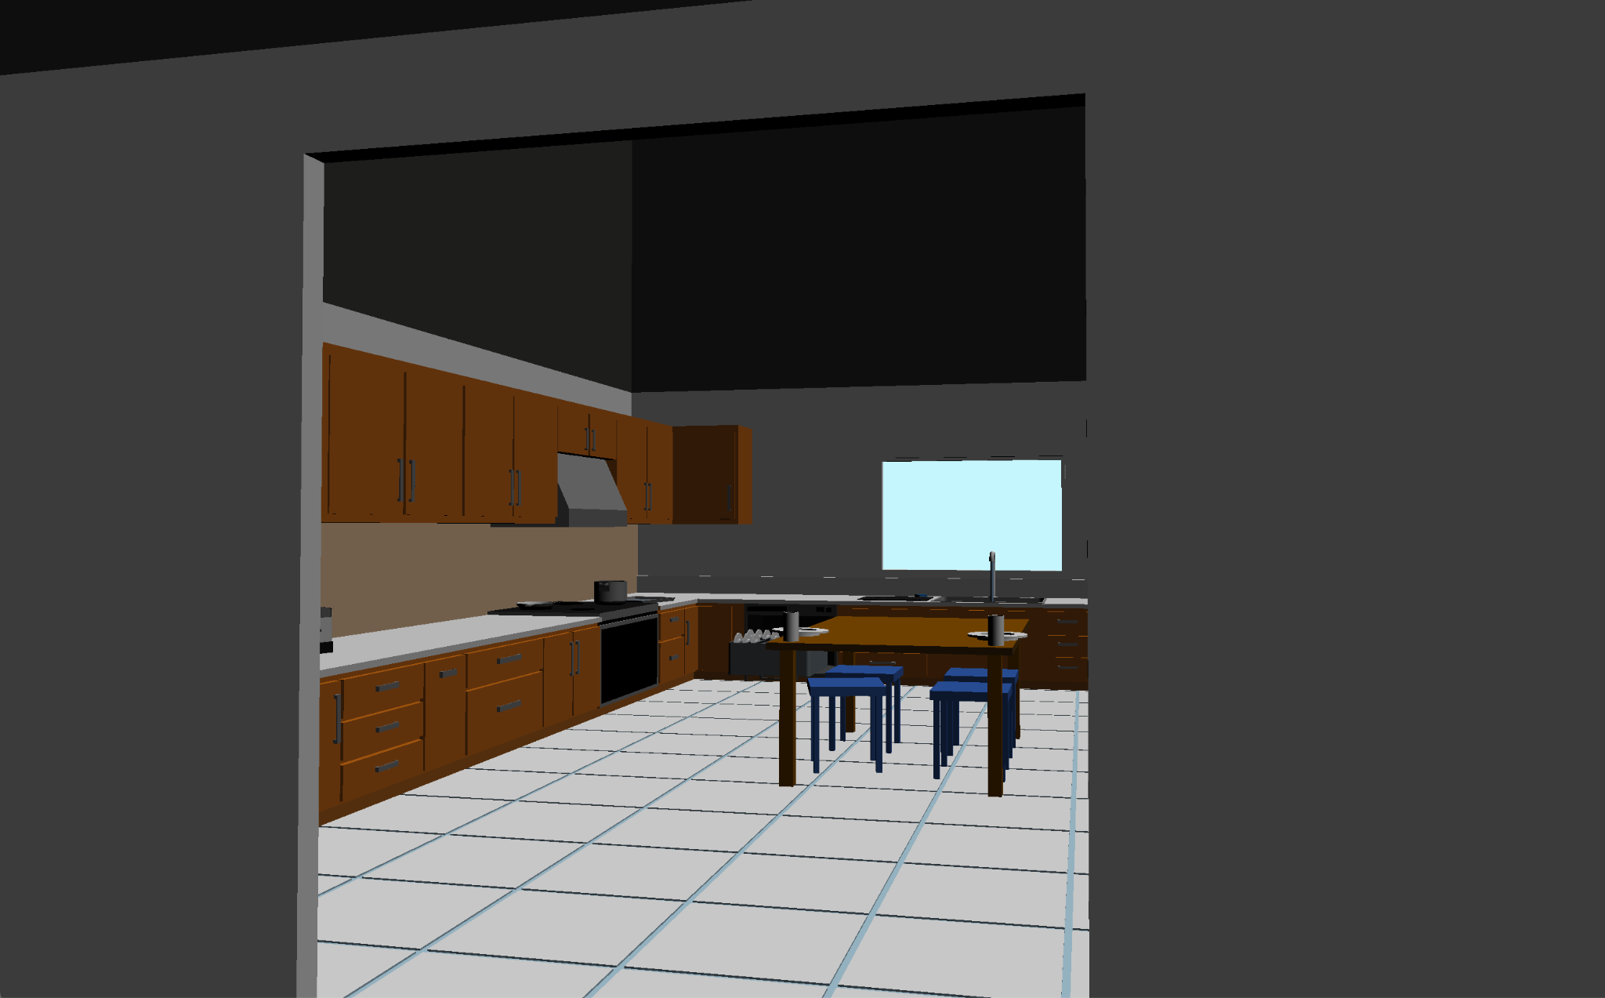
Figure 1. Views of Operating Environment.

Slide 5
Project Interaction
Initially planned to use Haptic Device but ran into several technical issues with setup
Controls: Keyboard Input
+
+
+
R
X-Axis MOvement
F
Y-Axis MOvement
V
Z-Axis MOvement
X
Close Gripper
-
-
-
T
X-Axis MOvement
G
Y-Axis MOvement
B
Z-Axis MOvement
C
Open Gripper
+
+
+
Y
X-Axis Rotation
N
Y-Axis Rotation
H
Z-Axis Rotation
Q
SWITCH TO BASE
-
-
-
U
X-Axis Rotation
M
Y-Axis Rotation
J
Z-Axis Rotation

Slide 6
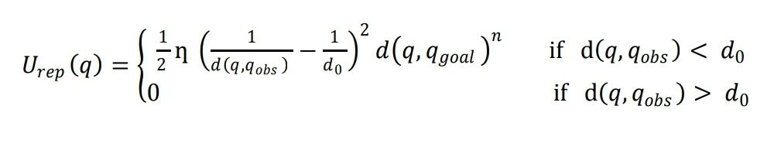
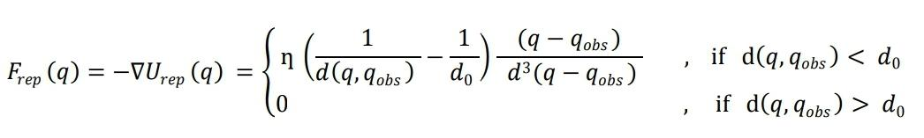
Planning and Control Strategies
Mobile Base (Autonomous)
Using a repulsive potential field for the central table
Obstacles are assumed to be small circular blobs distributed on the perimeter of the table
One 7-DoF arm (Keyboard)
Operational Space Controller

Slide 7

Mobile Base Navigation

Slide 8
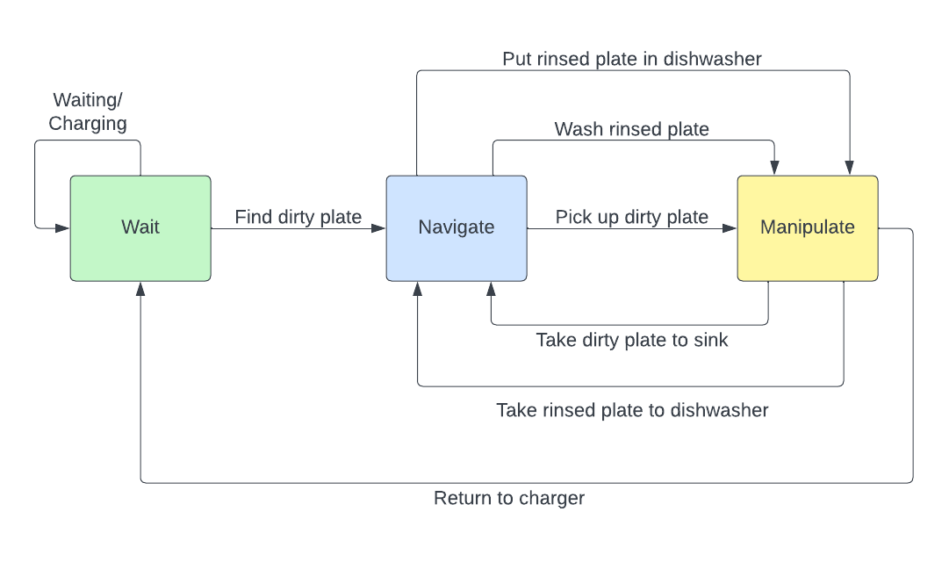
Control Description
State Machine:
States
Wait
Navigate
Manipulate
Tasks
Waiting / Charging
Find dirty plate
Pick up dirty plate
Take dirty plate to sink
Wash rinsed plate
Take rinsed plate to dishwasher
Put rinsed plate in dishwasher
Return to Charger
2 Control Modes: BASE and ARM Controller

Slide 9
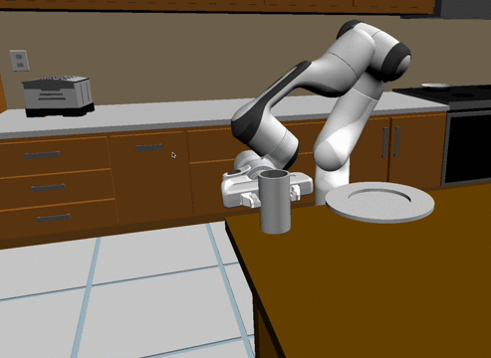
Challenges
Recognizing robotic gripper depth from 2D display
Collision Avoidance
Grasping plates and cups
Tuning the simulator’s dynamics and object(s) inertial properties
Interacting with and modifying dynamic objects
Creating a mobile and interactive dishwasher
Notes:
AJ

Slide 10
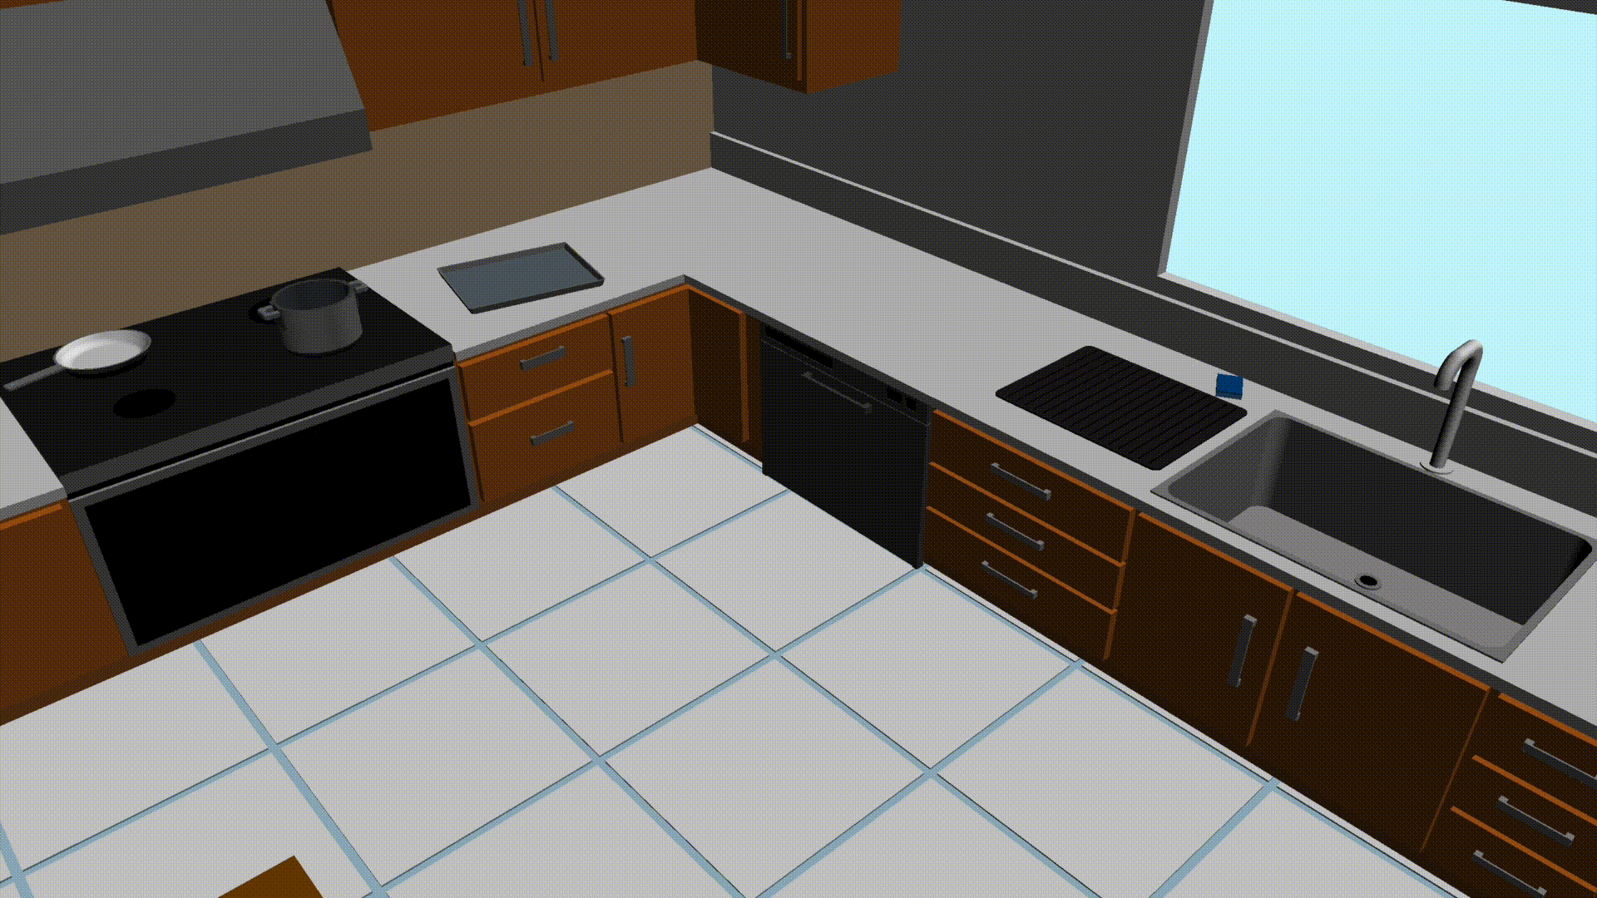
Figure 1. Working Implementation of Dynamic Dishwasher.

Slide 11
Future Work 🎯
Control robot through haptics
End effector camera with stereo vision
Improving/specializing gripper design for each dish type
Include support for a greater variety of dishes including cups and bowls
Incorporate a second arm to interact with the dishwasher
Increase room complexity to increase number of places dishes might be placed
Bussing in a restaurant setting
Implement mobile dish storage system to transport multiple dishes to the sink at once
Notes:
Add human safety component, requiring robot to navigate around moving “humans” who might also be in the room with the robot while cleaning

Slide 12
THANK YOU!
Any Questions?
Notes:
AJ

Slide 14
Work Timeline
Week 5 - Finalize project details and begin building out environment and robot
Create models for table, plate, and dishwasher
Week 6 - Continue developing environment; Begin work on navigation for mobile base and control strategy for manipulators
Week 7 - Continue developing integration of the haptic device for manipulator control
Week 8 - Finish navigation for the mobile base
Weeks 9 - Finish contact modeling & haptic control
Robot using haptics to pick up a plate and place it within the dishwasher
Weeks 9 - 10 - Work on extensions if time permits
June 8th (Week 10) - Final Project Presentation and Demo
AJ - Simulation Environment + Robot Design
Abhyudit - Control of mobile base and operational space control
David - Robot Manipulation (contact modeling / haptic control)
Notes:
AJ

Slide 15
+
+
+
R
X-Axis MOvement
F
Y-Axis MOvement
V
Z-Axis MOvement
X
Close Gripper
-
-
-
T
X-Axis MOvement
G
Y-Axis MOvement
B
Z-Axis MOvement
C
Open Gripper
+
+
+
Y
X-Axis Rotation
N
Y-Axis Rotation
H
Z-Axis Rotation
Q
SWITCH TO BASE
-
-
-
U
X-Axis Rotation
M
Y-Axis Rotation
J
Z-Axis Rotation

